Slide 1
Voltage Reference Design Considerations for a
High Performance System
Shailesh Khole
USPAS 2017 (LLRF Class)
20th January 2017

Slide 2
Introduction
Selection of Voltage Reference
Improvement in the performance!
Component Selection & Layout
How to test?
2
Shailesh Khole | Voltage Reference Design Considerations
1/20/2017

Slide 3
Voltage Reference Selection
The ADC noise budget is dominated by Voltage Reference noise as referred to ADC input
voltage reference stability and noise define measurement limits in instrumentation systems.
The Choice of Reference Voltage is decide by the ADC
On Chip Reference?
  On same die as that of digital and Analog switching sections
  ADC chip has speed dependent power loss
  Susceptible to noise and temperature drift
3
Shailesh Khole | Voltage Reference Design Considerations
1/20/2017

Slide 4
ADC Specifications
AD9656 has 2dB additional
SNR at 16MHz
4
Shailesh Khole | Voltage Reference Design Considerations
1/20/2017

Slide 5
Voltage Reference Specifications
High accuracy
Low noise
Current drive capacity
Good load regulation
Low thermal drift
Low Long term drift
Low environment sensitivity
Low dropout voltage
1.4V is a non standard value
LTC 6655-2.5
5
Shailesh Khole | Voltage Reference Design Considerations
1/20/2017

Slide 6
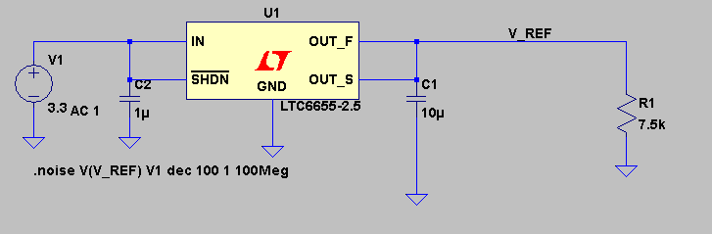
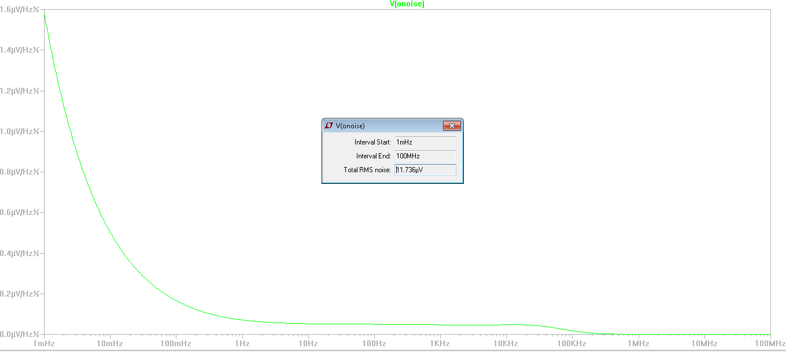
Noise performance
6
Shailesh Khole | Voltage Reference Design Considerations
1/20/2017

Slide 7
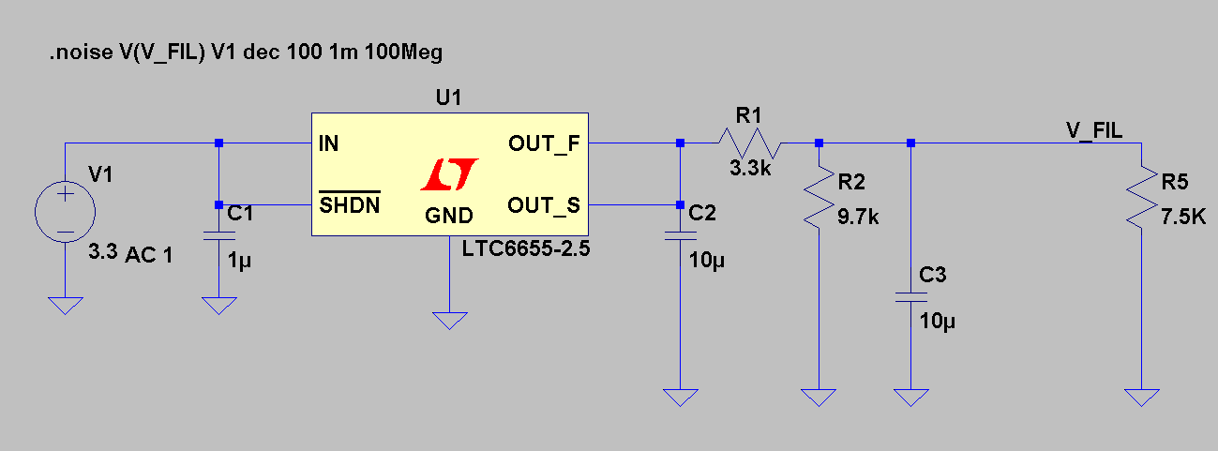
Can we Improve It?
7
Shailesh Khole | Voltage Reference Design Considerations
1/20/2017

Slide 8
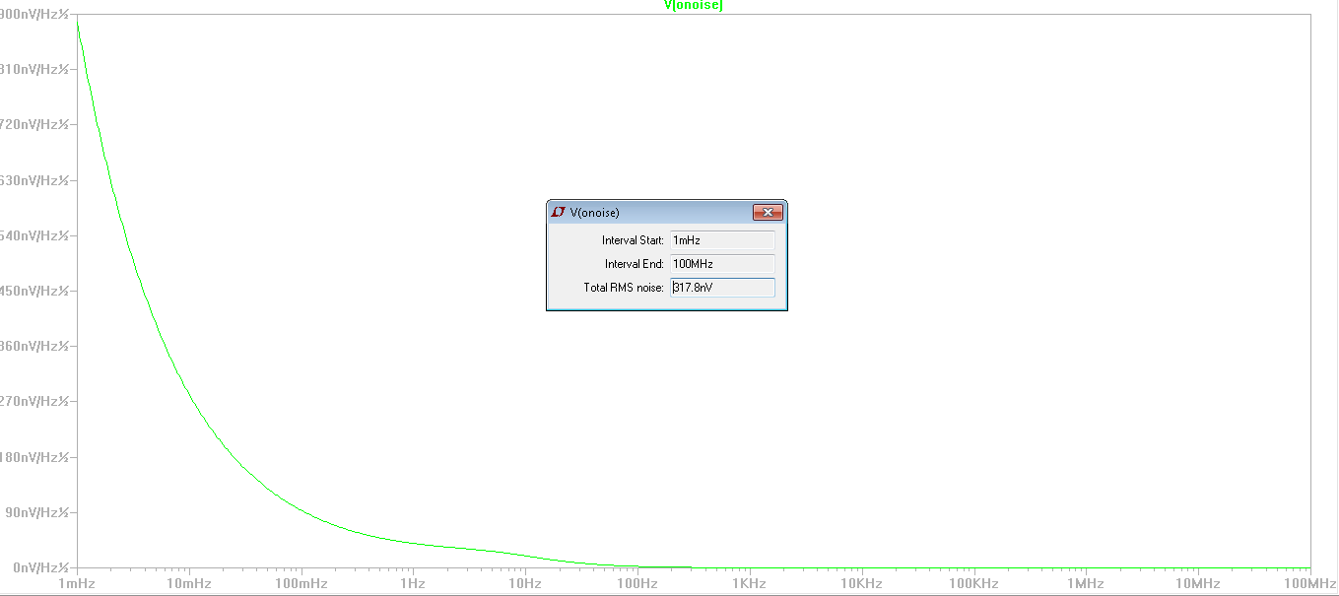
Can we Improve It?
8
Shailesh Khole | Voltage Reference Design Considerations
1/20/2017

Slide 9
What about ADC Reference Resistor
ADC internal Impedance is deciding the voltage
ADC internal Impedance is temperature dependent
It can very as much as 10% with temperature and varies from device to device
Multiple ADC will disturb the Reference voltage
Voltage reference output impedance is high
9
Shailesh Khole | Voltage Reference Design Considerations
1/20/2017

Slide 10
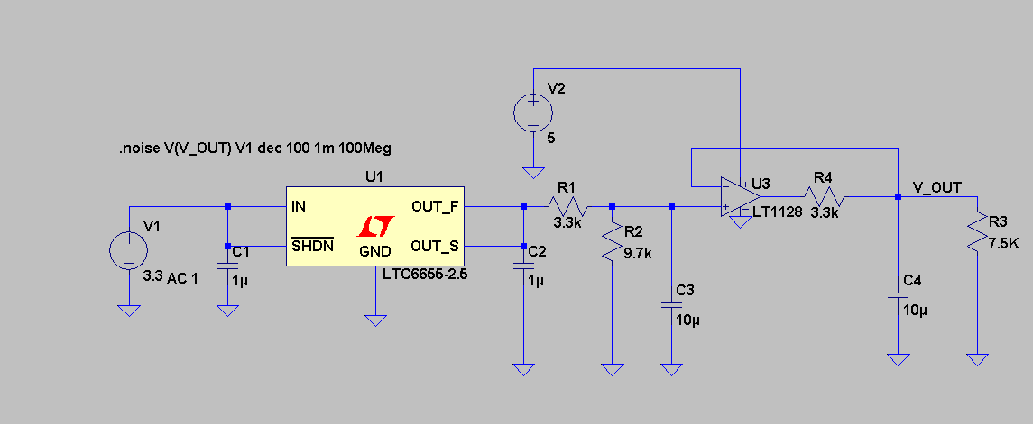
Low Noise Buffered output
10
Shailesh Khole | Voltage Reference Design Considerations
1/20/2017

Slide 11
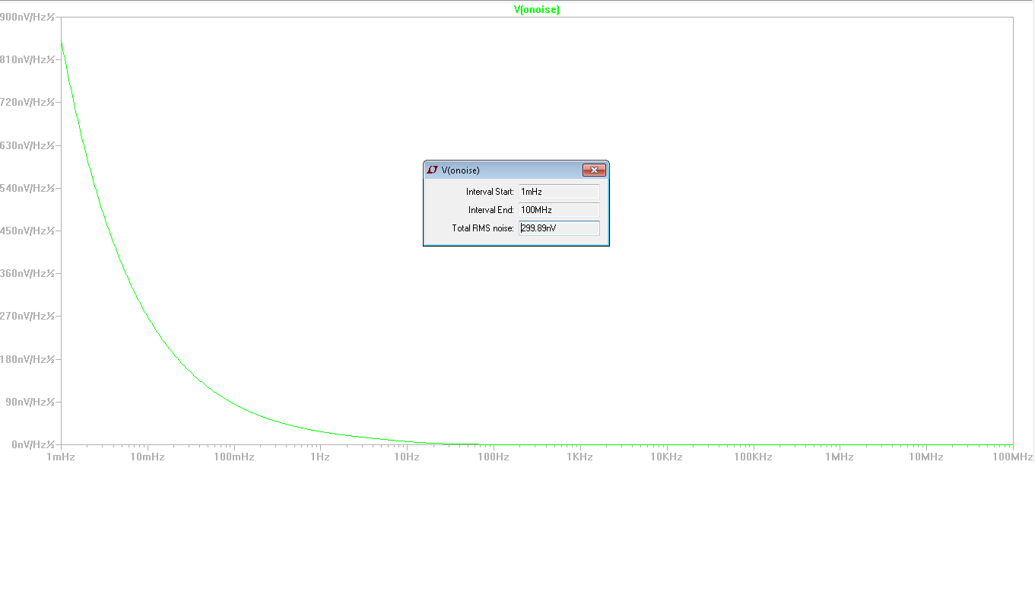
Low Noise Buffered output
11
Shailesh Khole | Voltage Reference Design Considerations
1/20/2017

Slide 12
Layout and component selection
Never use ceramic capacitors. On even on power supply lines of ADC and Reference. They generate micro-phonics. Use NP0 capacitors
Use an LDO to power the reference chip
Keep a continuous ground plane below the chip for noise isolation and thermal heat removal
Place reference section close to ADC
Shield the Reference output lines
12
Shailesh Khole | Voltage Reference Design Considerations
1/20/2017

Slide 13
Testing of Reference
The Key specification of testing is
    Reference 1/f noise
    Reference white noise
    Reference RMS noise
    Reference drift with time
    Reference transient load response
1/f noise measurement needs special kind of testing unit
    The measuring instrument 1/f performance will dominate the results.
13
Shailesh Khole | Voltage Reference Design Considerations
1/20/2017

Slide 14
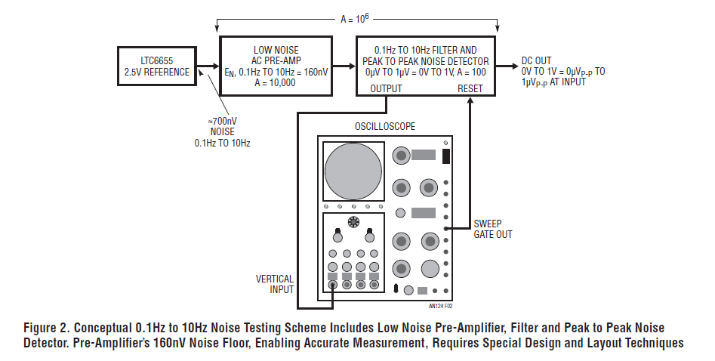
Measurement unit
14
Shailesh Khole | Voltage Reference Design Considerations
1/20/2017

Slide 15
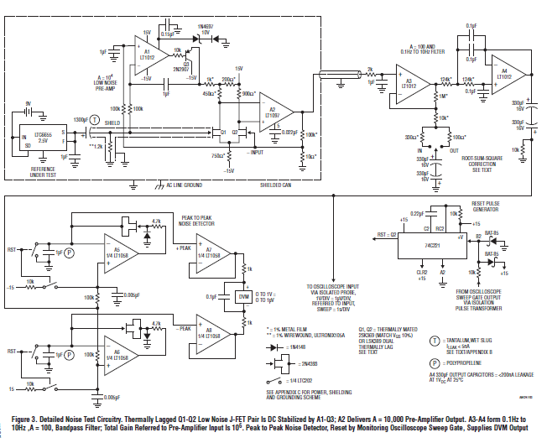
Measurement unit
15
Shailesh Khole | Voltage Reference Design Considerations
1/20/2017

Slide 16
References
Linear Technology
  LT 6655 Data sheet
  LT 1128 Data sheet
  Application Note AN124
Analog devices
  AD9656 Data sheet
  Application Note AN835 for ADC specification testing and performance evaluation
16
Shailesh Khole | Voltage Reference Design Considerations
1/20/2017

Slide 17
Thanks
17
Presenter | Presentation Title
1/20/2017

